Slide 1

BASIC UNDERSTANDING OF
AI

Slide 2
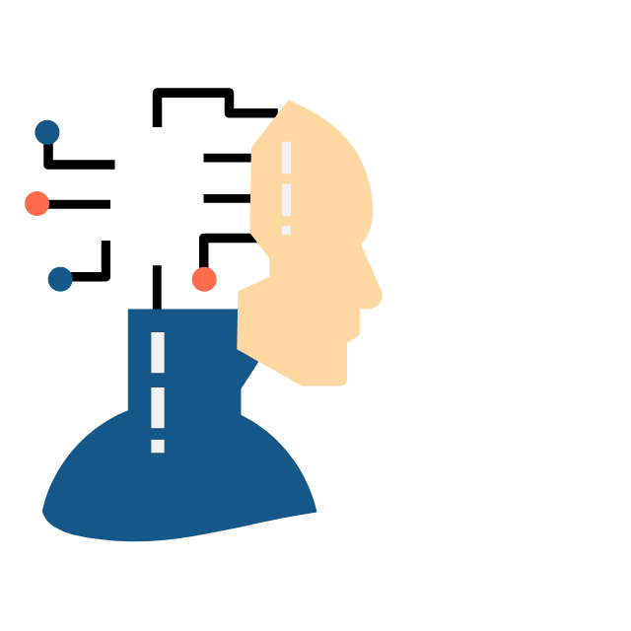
01
01

Slide 3
EXPLAIN THE CONCEPT OF ARTIFICIAL INTELLIGENCE?
The evolution from manpower to steam engines etc to the era of Cognitive computing where the computer acts and mimics/ thinks like the human brain. So, therefore, a computer/ machine should exhibit intelligence identical/ likened to that of humans.
02

Slide 4
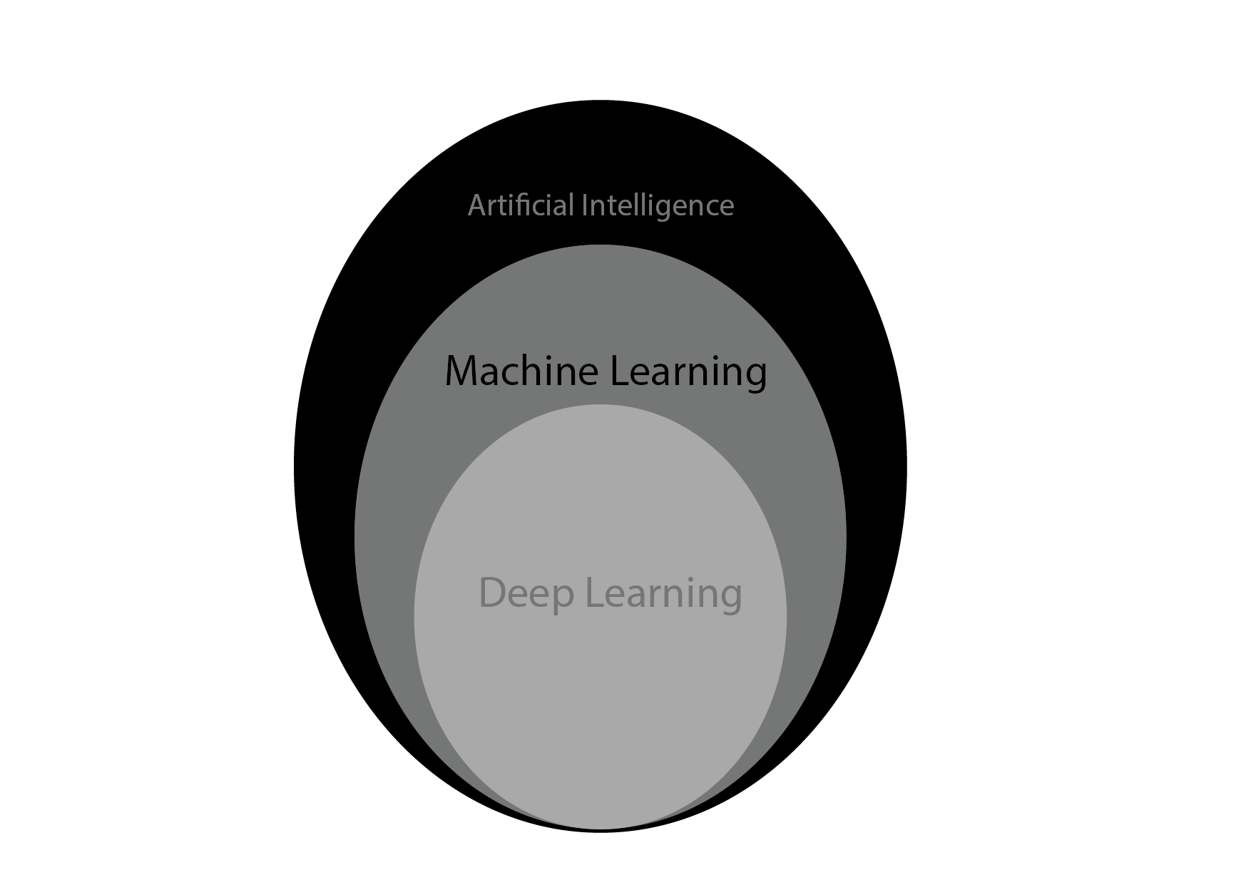
EXPLANATION?
03

Slide 5
TYPES OF ARTIFICIAL INTELLIGENCE
Weak AI - Specialized in a given task. example; Chatbots
Strong AI-Exhibits Human-level intelligence. examples; DeepMind project, Human brain project, and OpenAI.
04

Slide 6
LEVELS OF AI
Artificial Narrow Intelligence (ANI): the machine is good at doing repetitive tasks and simple automation. eg chatbots & virtual assistants; Siri, Cortana, etc
Artificial General Intelligence (AGI): machines that can perform intelligently any tasks as humans.
Artificial Superintelligence (ASI)- Smarter than humans and all the intelligent people ever lived on this earth and thus, the machine should have self-awareness.
05

Slide 7
ARTIFICIAL INTELLIGENCE VS HUMAN SYSTEM
How the human system works( Senses the environment, make interpretation of what it senses, makes decisions on the interpreted information).
How Artificial Intelligence works is similar to that of the human system:( Input data, makes inferences on the data, predicts the output).
06

Slide 8
TYPES OF PREDICTION
Deterministic outcome: the output can be clearly defined. For example, if your type an alphabet (A) on your keyboard, you'd expect an (A) to be displayed on your screen.
Probabilistic outcome: the output is determined by some statistical values/ responses.
07

Slide 9
MACHINE LEARNING
Machine learning is a field in Computer Science that allows computers to learn from data; learn and recognize patterns in data to make predictions without being explicitly programmed. Machine Learning is a subset of Artificial Intelligence.
Machine Learning is used in our daily life, from Email spam filtering to search engine results.
08

Slide 10
TYPES OF MACHINE LEARNING
Supervised ML(Training on labeled data). The model's output should be similar to its input. eg pressing an (A) on the keyboard should display an (A) on the monitor.
Unsupervised ML(training on unlabeled data). The goal is to detect patterns in data to make predictions.
Reinforced ML(training on interaction with the environment). based on rewards and punishment. eg A robot finding its path through trials and errors.
09

Slide 11
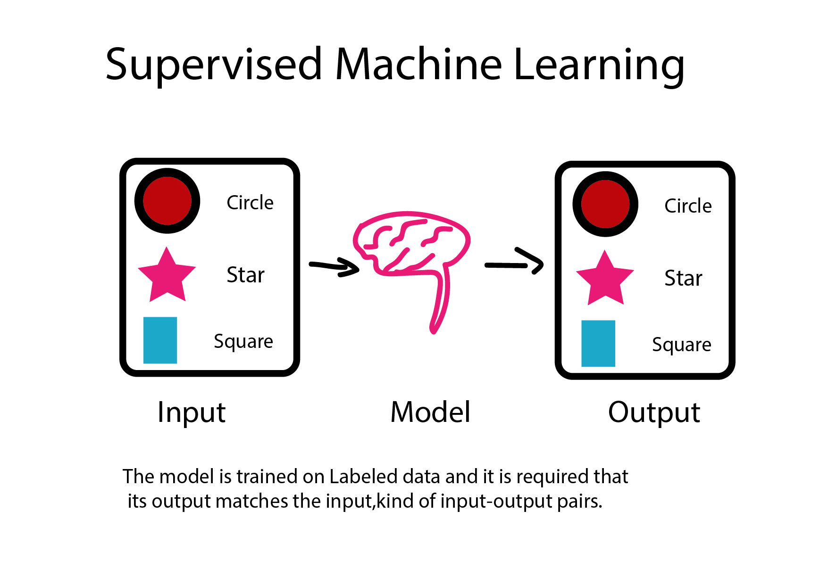
TYPES OF MACHINE LEARNING
10

Slide 12
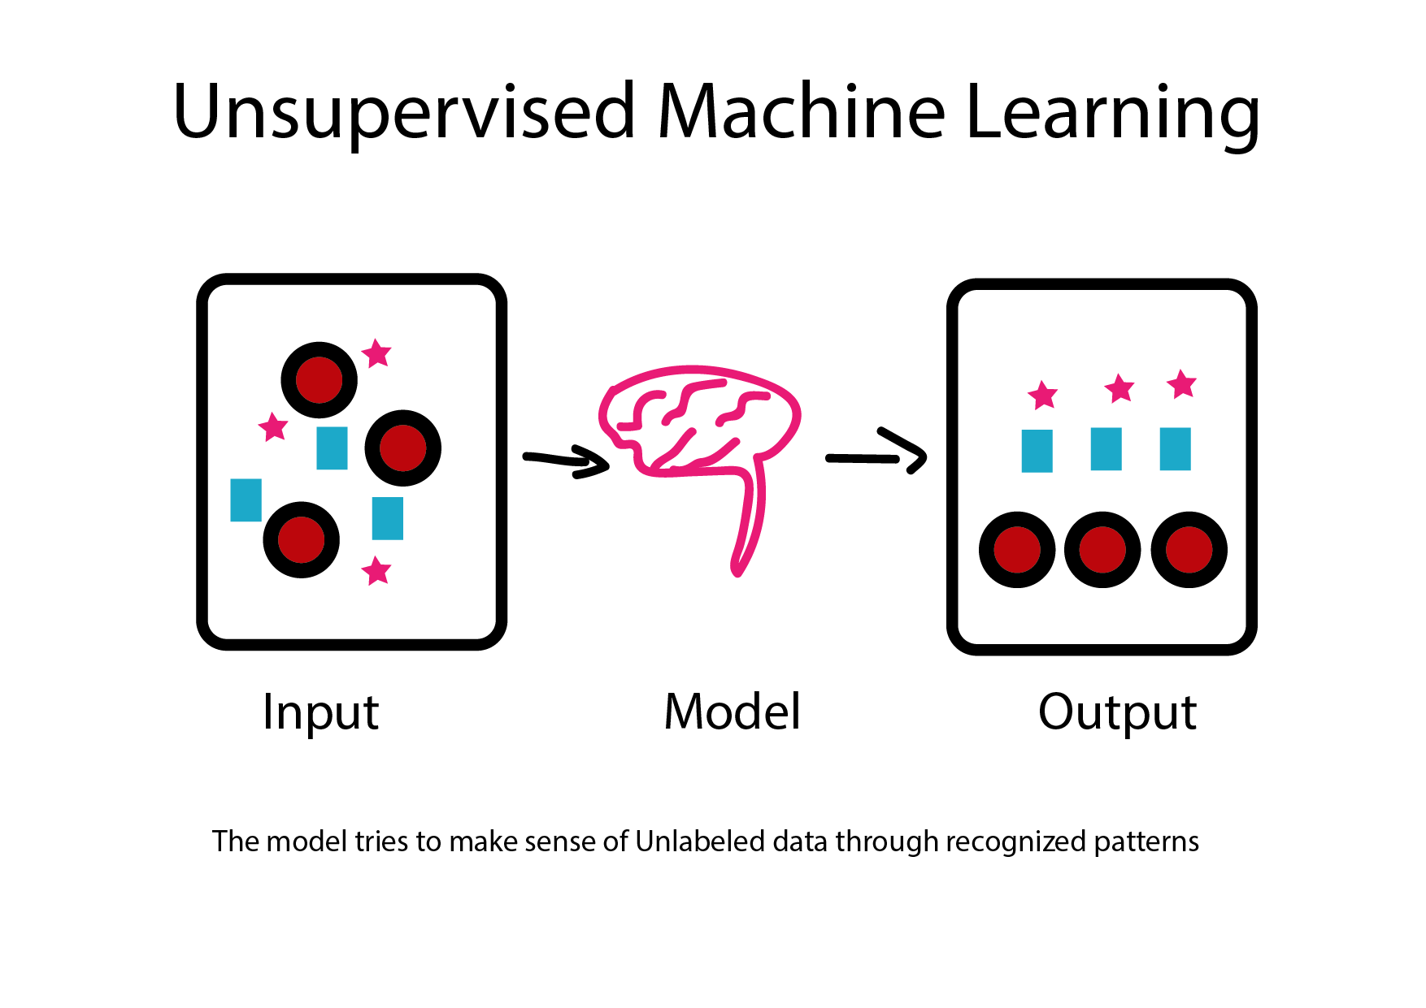
TYPES OF MACHINE LEARNING
11

Slide 13

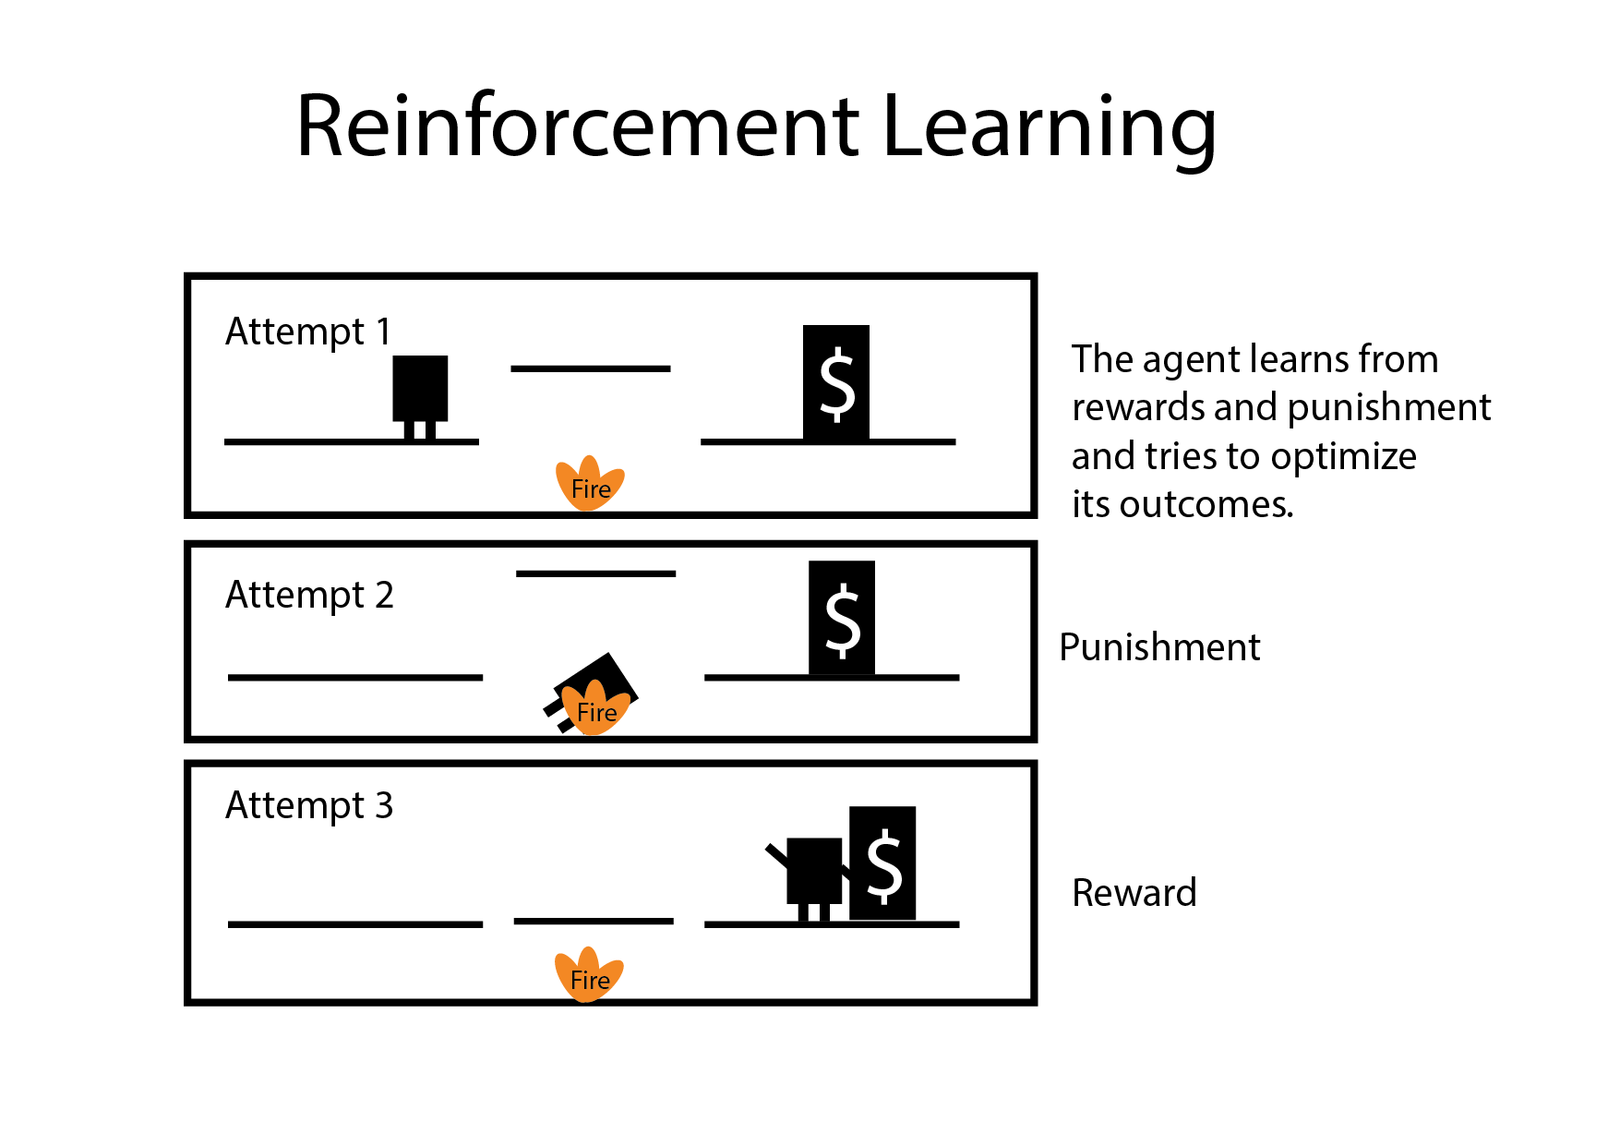
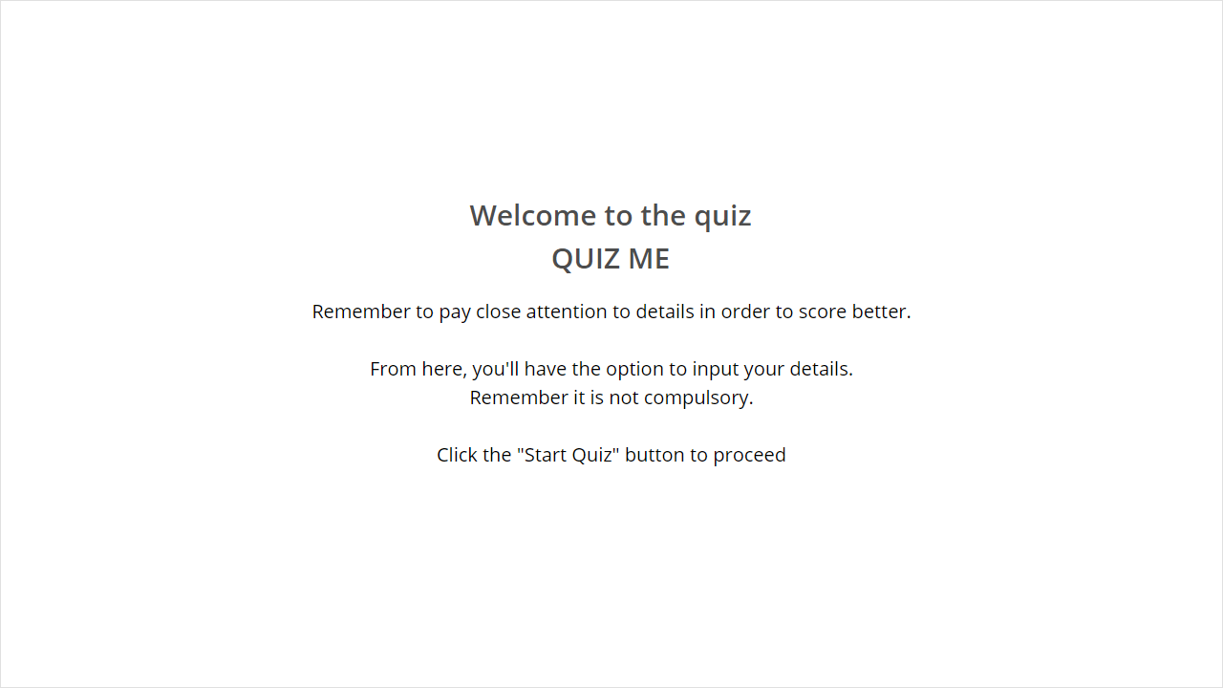
Quiz
TYPES OF MACHINE LEARNING
Click the Quiz button to edit this object
Reinforcement Learning
12

Slide 14
THANK
YOU

